Slide 1

VALUE: DEFINED BY WHOM?
Notes:
Welcome to this Movement Is Life™ part 1 of 2, webinar on “Value in Health Care”. Movement is Life is a multi-disciplinary coalition seeking to eliminate racial, ethnic, gender and geographic disparities in muscle and joint health by promoting physical mobility to improve quality of life among, African American, Hispanic/Latina and women who live in rural communities. Since 2010, Movement Is Life has focused on the elimination of musculoskeletal disparities in health care. Limited mobility due to joint pain has a dramatic impact on co-morbid health conditions, including obesity, type 2 diabetes, and heart disease.

Slide 2

MOVEMENT IS LIFE™
Disclosure
Movement is Life is underwritten by Zimmer Biomet
Notes:
The MOVEMENT IS LIFE™ CAUCUS RECEIVES FINANCIAL SUPPORT FROM ZIMMER BIOMET.

Slide 3

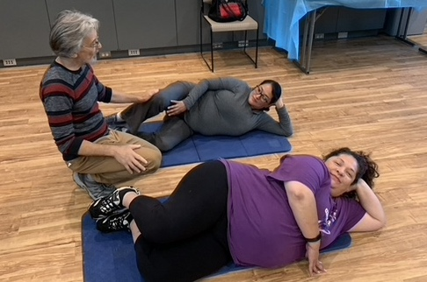
MIL GOALS
Raise Awareness
Notes:
To review, Movement is Life’s goals are to:
RAISE AWARENESS of the epidemic of limited mobility and develop functional solutions to reduce disparities;
STRATEGIZE with health care providers, community leaders and other stakeholders to combat disabling joint pain among women, African Americans, and Hispanics;
IMPLEMENT community-based initiatives to combat arthritis and co-morbid conditions that lead to immobility;
ADVOCATE to decrease musculoskeletal health disparities that contribute to joint pain and immobility, and
EDUCATE patients on the importance of daily physical activity in decreasing poor joint health and improving overall health.

Slide 4
MIL GOALS
Raise Awareness
Strategize
Notes:
To review, Movement is Life’s goals are to:
RAISE AWARENESS of the epidemic of limited mobility and develop functional solutions to reduce disparities;
STRATEGIZE with health care providers, community leaders and other stakeholders to combat disabling joint pain among women, African Americans, and Hispanics;
IMPLEMENT community-based initiatives to combat arthritis and co-morbid conditions that lead to immobility;
ADVOCATE to decrease musculoskeletal health disparities that contribute to joint pain and immobility, and
EDUCATE patients on the importance of daily physical activity in decreasing poor joint health and improving overall health.

Slide 5
MIL GOALS
Raise Awareness
Strategize
Implement
Notes:
To review, Movement is Life’s goals are to:
RAISE AWARENESS of the epidemic of limited mobility and develop functional solutions to reduce disparities;
STRATEGIZE with health care providers, community leaders and other stakeholders to combat disabling joint pain among women, African Americans, and Hispanics;
IMPLEMENT community-based initiatives to combat arthritis and co-morbid conditions that lead to immobility;
ADVOCATE to decrease musculoskeletal health disparities that contribute to joint pain and immobility, and
EDUCATE patients on the importance of daily physical activity in decreasing poor joint health and improving overall health.

Slide 6
MIL GOALS
Raise Awareness
Strategize
Implement
Advocate
Notes:
To review, Movement is Life’s goals are to:
RAISE AWARENESS of the epidemic of limited mobility and develop functional solutions to reduce disparities;
STRATEGIZE with health care providers, community leaders and other stakeholders to combat disabling joint pain among women, African Americans, and Hispanics;
IMPLEMENT community-based initiatives to combat arthritis and co-morbid conditions that lead to immobility;
ADVOCATE to decrease musculoskeletal health disparities that contribute to joint pain and immobility, and
EDUCATE patients on the importance of daily physical activity in decreasing poor joint health and improving overall health.

Slide 7
MIL GOALS
Raise Awareness
Strategize
Implement
Advocate
Educate
Notes:
To review, Movement is Life’s goals are to:
RAISE AWARENESS of the epidemic of limited mobility and develop functional solutions to reduce disparities;
STRATEGIZE with health care providers, community leaders and other stakeholders to combat disabling joint pain among women, African Americans, and Hispanics;
IMPLEMENT community-based initiatives to combat arthritis and co-morbid conditions that lead to immobility;
ADVOCATE to decrease musculoskeletal health disparities that contribute to joint pain and immobility, and
EDUCATE patients on the importance of daily physical activity in decreasing poor joint health and improving overall health.

Slide 8

Notes:
Today’s discussion is driven by the development of the Value monograph you see here. This Monograph started out as a need to better understand evolving changes in healthcare payment policy. MIL sought to answer the question: Is there Value in the current healthcare system and if so to whom? After 2 years of conceptualizing and debate; a review of the literature; and feedback from patient focus groups; the Value Monograph was developed and published.

Slide 9

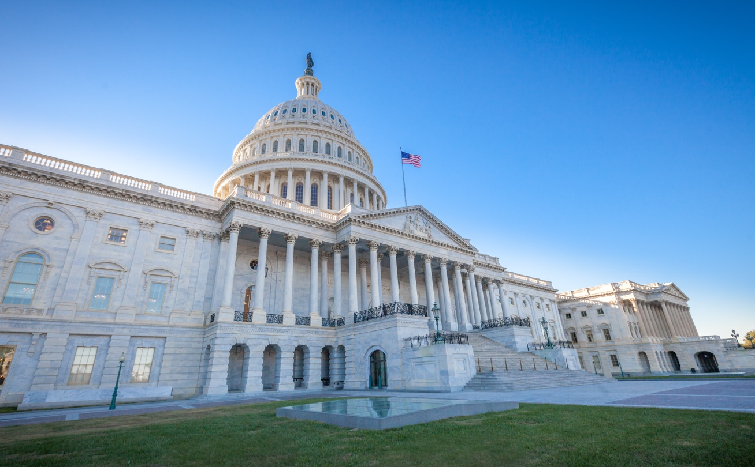
WHAT DEFINES VALUE FOR KEY STAKEHOLDERS?
Patients
Providers
Payers, Regulators/ Policy Makers
Notes:
The “stakeholders”, who have a vital interest in defining “value” in health care, include (of course) patients, the providers who serve them, and payors and policy makers who define how providers are paid for their services/care.

Slide 10

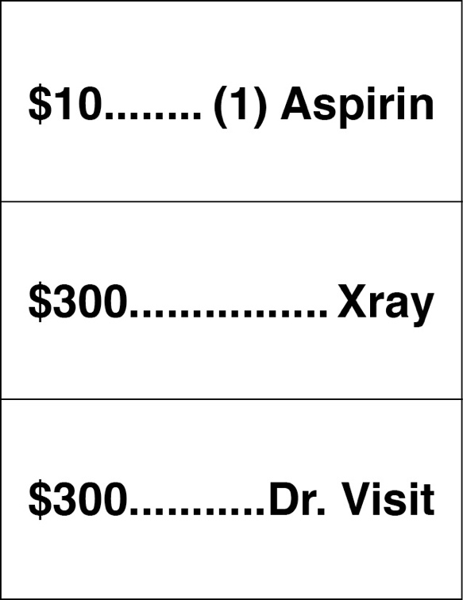
VALUE = THE BALANCE
Between Patient Centered Outcomes, Services Utilized and Costs Incurred
Patient Achieves Health/Functional Goals
System Provides “Right/Most Appropriate Service”:
Cost Effective
Efficient
Notes:
In general terms, “value” is often defined as “quality” divided by cost. Value implies a balance among patient outcomes, the services used to achieve those outcomes, and the cost of those services.
When this balance is reached, patients achieve their goals for function and overall health, providers give the most appropriate services efficiently, and the health care services provided are cost-effective.

Slide 11

ARE VALUES IN OUR CURRENT SYSTEM BALANCED?
Cost (https://www.pgpf.org)
Complexity
Incentives
Conflict (Catalyst.Nejm.Org 2018)
Notes:
In our current health care system, stakeholder values are not balanced. The cost of health care in the US is not sustainable. Although the United States spends significantly more per person on healthcare than other industrialized nations, our health outcomes are no better — and often worse. (Peter G. Peterson Foundation) Unfortunately, the system is complex, and stakeholders are at odds
https://www.pgpf.org/infographic/infographic-us-healthcare-spending?utm_term=healthcare%20outcomes%20by%20country&utm_campaign=Healthcare+Infographic&utm_source=adwords&utm_medium=ppc&hsa_acc=1523796716&hsa_cam=901124848&hsa_grp=52620067643&hsa_ad=386166142251&hsa_src=g&hsa_tgt=kwd-329647557082&hsa_kw=healthcare%20outcomes%20by%20country&hsa_mt=b&hsa_net=adwords&hsa_ver=3&gclid=Cj0KCQjwvr6EBhDOARIsAPpqUPEluC8V4XMWDZAOxsLTw1xe1djCLdcYLxv4gPSv2grFx6Pzn-Gm5ZYaAktpEALw_wcB

Slide 12

HOW DO OUR PATIENTS DEFINE VALUE?
What really matters to them?
Do their experiences suggest a way to better care?
Notes:
Unfortunately, patients are typically viewed as the third group of stakeholders in our healthcare system. So, who are typically considered the most important stakeholders? That’s right, payors and providers are often viewed as the most important stakeholders. That begs the question, where does the patient perspective come into play?
Today, most definitions of quality in health care include a component of the “patient experience”, assessed by instruments like the CAHPS or Press Ganey surveys. But what do patients in disadvantaged communities really value in their health care encounters? What really matters to them? How do alternative payment systems affect the value patients receive?
Finally, how can we as individual providers improve the value of our care for our patients?

Slide 13

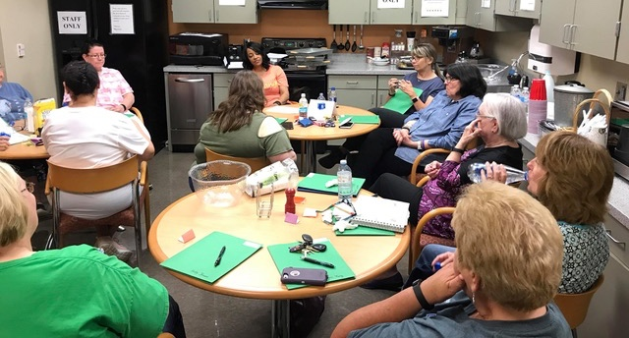

MOVEMENT IS LIFE – FOCUS GROUPS
Focus Groups
Cleveland (African-American Women)
Chicago (Hispanic Women)
Kentucky (Rural Community Health Workers)
Notes:
To better understand what patients value, Movement is Life convened Focus groups of Women representing communities of color (African American in Cleveland) (Hispanic in Chicago) as well as community health workers in rural Kentucky, to identify the challenges and frustrations they experienced in their interactions with their providers and healthcare system.

Slide 14

FRUSTRATIONS – COMMON THEMES
Lack of:
Communication
Competence
Professionalism
Notes:
In all three focus groups, common challenges and sources of frustration they encountered during an interaction with their provider included:
An overall lack of communication, or impaired communication;
A lack of competence or failure to attend to patients’ needs;
And a lack of professionalism;
A lack of courtesy; and
A perception of provider bias

Slide 15

FRUSTRATIONS – COMMON THEMES
System Challenges
IT
EHR
Insurance/Out Of Pocket Costs
Failure To Recognize Or Manage Appropriately - Common Conditions
Depression
Sequelae Of Diabetes
Notes:
Other common frustrations were healthcare system problems involving:
Electronic health records and financial concerns, including insurance coverage gaps and out of pocket costs;
Failure to recognize or manage common conditions, such as depression and the end organ damage caused by diabetes
System challenges may be beyond our control. However, there are multiple ways in which we, as providers, can enhance the value of our patient interactions.

Slide 16

LACK OF COMMUNICATION
“The doctors no longer even look at us, they’re just at the computer. It’s frustrating.”
“I find it so irritating and frustrating to go to the hospital and have to explain the same thing to twelve different people. I think that is so ridiculous.”
Case Study 1
Notes:
The most common frustration among the participants in all three focus groups was deficient communication, both between clinicians and patients and among providers. They felt the physicians or NPs/PAs were more interested in their computer than looking or listening to them.
For a more in-depth discussion, please see Case Study: Value Patient Vignette 1.

Slide 17

LACK OF COMPETENCE, ATTENTION TO PATIENT NEEDS
“With my family history, you want me to come back to your office in six months?” He said ‘yes. You should be more concerned about your grocery bill than you are about this lump.’”
Patient with diagnosis of breast cancer
Case Study 2
Notes:
Providers often failed to address patients’ needs and concerns. They failed to engage both the patients as persons and the patients’ agendas for the visit.
For a more in-depth discussion, please see Case Study: Value Patient Vignette #2

Slide 18

LACK OF PROFESSIONALISM, BIAS
“He (the doctor) said, ‘have you ever been addicted to any pain medication?’…He just automatically wrote me off as a drug addict...It was so degrading to me.”
Case Study 3
“My son was covered in blood, his head open.
I heard the nurse when she said, ‘A gang member more, a gang member less.’”
Case Study 4
Notes:
Many of the focus group members perceived their care as discourteous or disrespectful. They felt that providers were openly biased against them. One perceived bias is related to the current Opioid Addiction crisis. The second, more longstanding stereotyping, is a perceived bias against the Latinx population.
For in-depth discussion of the pain medication issue see Case Study: Value Patient Vignette 3.
For in-depth discussion of the second case see Case Study: Value Patient Vignette 4

Slide 19

HEALTHCARE SYSTEM CHALLENGES
“Now, they’re giving you quotes up front – what your estimate will be after the insurance has paid – and they ask you for that money in advance.”
“Yes, that’s the one thing you can count on, getting the bill.”
“No, we can’t see you. Go to urgent care.”
Notes:
Patients consistently identified the policies, procedures, and processes of the healthcare system and out-of-pocket costs as frustrations and barriers to receiving care.
Although we probably can’t control payment policies, we should be aware that such policies are barriers to our patients’ ability to receive care.

Slide 20

COMMON CONDITIONS NOT MANAGED APPROPRIATELY
“I don’t think doctors know how to identify depression.”
“I was diagnosed with breast cancer. I had surgery and treatment. I went to see this new primary doctor…I’m tired and she’s telling me to go workout and you won’t be tired. Lady, I can barely go to work! I go to work and I come home and I don’t even make it to the bedroom – I make it to the couch.”
Case Study 5
Notes:
Providers often failed to identify or manage common conditions such as depression. Many of the patients in the focus groups were diabetic and commented on failures to manage even the most common morbidities associated with their diabetes.
See Case Study: Value Patient Vignette #5

Slide 21


PATIENT PRIORITIES FOR A BETTER HEALTHCARE SYSTEM
Clear, Efficient, Effective Communication
“If I call the doctor, I’d like for them to return my phone call.”
“The most important thing for me, when I go to see a doctor, is having a good dialogue with my doctor. For him to understand me and for me to understand him.”
Notes:
Patients not only identified problems but also offered solutions that addressed their needs. Regarding communication, patients desire prompt responses to phone calls and a dialogue between provider and patient.
An effective provider-patient dialogue requires respectful treatment and attentive listening.

Slide 22

PATIENT PRIORITIES FOR A BETTER HEALTHCARE SYSTEM
Respectful, Unbiased, Nonjudgmental Care
“If I’m going to the doctor and you’re my kids’ age, you don’t call me by first name. Don’t call me Sweetie.”
“For them to consider us human beings. Not like a number or as a money maker for the insurance companies.”
“They ask: ’How are you feeling? Why are you here today?” Then they listen.”
Case Study 6
Notes:
Patients expect respectful, unbiased, non-judgmental care. They expect their dignity as human beings to be acknowledged and protected.

Slide 23

PATIENT PRIORITIES FOR A BETTER HEALTHCARE SYSTEM
Timely Care – Prompt, Professional, Courteous
“Once you sign in, they would call you within a normal time, and not have you sit forever.”
“A short wait.”
“If your blood pressure is high, they ask you ‘Are you doing anything different?’”
Notes:
Patients want – and need - their care to be timely, prompt and professional.

Slide 24

PATIENT PRIORITIES FOR A BETTER HEALTHCARE SYSTEM
Personalized Care –
“He was interested in what I needed. He didn’t want me walking out of his office forgetting to ask a question. He was always attentive to my health.”
If they are diabetic, how about, ‘how long has it been since you’ve had an eye exam? A diabetic should have one every year.”
“I want to partner with my healthcare doctor who will work with me compassionately.”
Notes:
Patients want – and need - care that is personalized to their unique needs. Proper care should be tailored to their needs and the best available evidence, not the patient’s insurance status. They want their providers to partner with them and share the decision-making process.
NOT DRIVEN BY INSURANCE TYPE
PRACTITIONER IS COMPASSIONATE AND WILLING TO PARTNER WITH THE PATIENT
SHARED DECISION-MAKING

Slide 25

PATIENT PRIORITIES FOR A BETTER HEALTHCARE SYSTEM
Sensitivity to Out-Of-Pocket Cost
“A huge thing is they are not aware of how much the medicine costs that they are prescribing…‘Is there a generic I can call-in instead of the name brand?’
Notes:
Patients expect their providers to be aware of the cost of the care they recommend. The cost of some prescriptions, for example, may force the patient to choose between buying the prescription, buying groceries or paying the rent. In such instances, “non-compliance” with recommended care may be unavoidable – but could cause them to be “dropped”!

Slide 26
WHAT PATIENTS VALUE:
Care that Is:
TIMELY
COST – CONSCIOUS
UNBIASED, RESPECTFUL AND COMPREHENSIVE
REFLECTS PROFESSIONALISM
COMMUNICATION that is:
Effective
Supports the provider-patient relationship
Notes:
To summarize, patients want – and need - timely, cost-conscious, professional care. They need care that is respectful and comprehensive. Most of all, they value effective communication with their providers.
What characterized the patient’s ideal healthcare? They characterized ideal healthcare as patient-centered, with dialogue to ensure effective interaction, understanding and shared decision-making. Respectful, unbiased, nonjudgmental care was emphasized by all groups. Most of all they value humanism.

Slide 27

https://www.movementislifecaucus.com
Notes:
So, are healthcare payment models impacting care? In Part 2 of this series, we will explore this issue and provide a brief overview of payment models for you to consider.
For the perspectives of health care providers, policy makers, and payers, please go to “Value in Health Care, Part 2”

